Slide 1
Group 5C GAM110 Pitch Battle for Eradel (Working Title)
By Will Bourne, Ashley Perks, Billy Marsh, Joey Hines, Joel Squires-Purnell, Collin Butterworth, Ben Rawlings, Josh Fildes & Marcel Hara

Slide 2
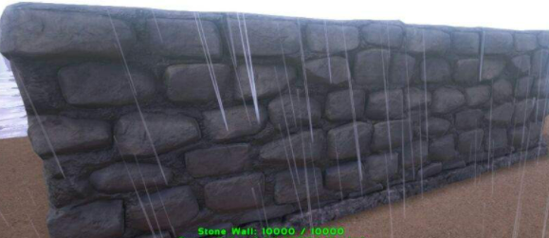
Game Objective
Billy
The objective of the game is to be the LMS(Last Man Standing). This means that you need to destroy the other castle/base before yours is destroyed.
Each castle/base will have
A specific amount of health.
[1]

Slide 3
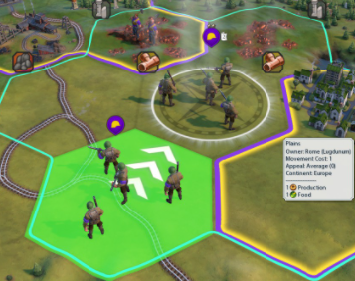
USP
Billy
Our USP for our game is the combination of a typical Tower Defence game and a Real Time Strategy (RTS) game.
We are leaning more towards an RTS design
(units, lanes, economy control)
[2]

Slide 4
Features
Joel
Pick and choose the type of troops you would like to attack the opponent at the start of every round.
Strategically choose lanes to attack from.
The player must destroy the opponent’s castle, and to defend their own castle from the opponent.

Slide 5
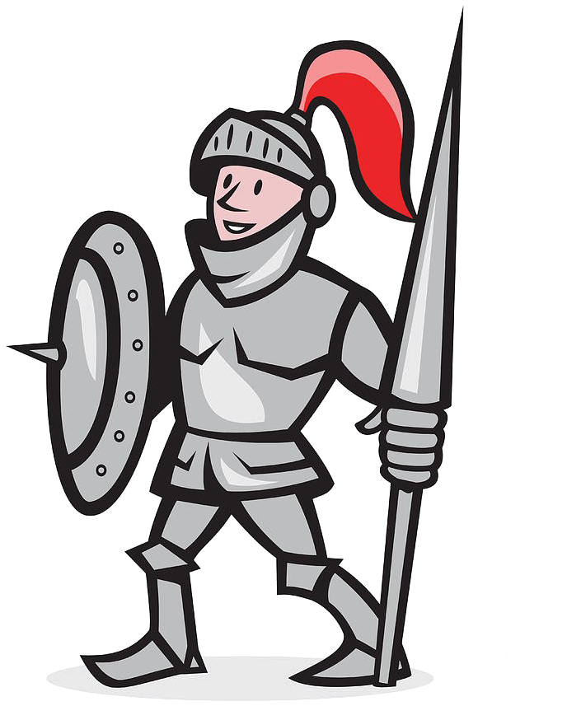

Combat & Defence
Ashley
Combat occurs automatically when opposing troops are near each other
They will keep battling until there are no opposing troops remaining
Troop types:
Warrior
Brute
Archer
Mage
Healer
Assassin
If there are no enemy troops on the field, then troops will target the enemy’s castle.

Slide 6
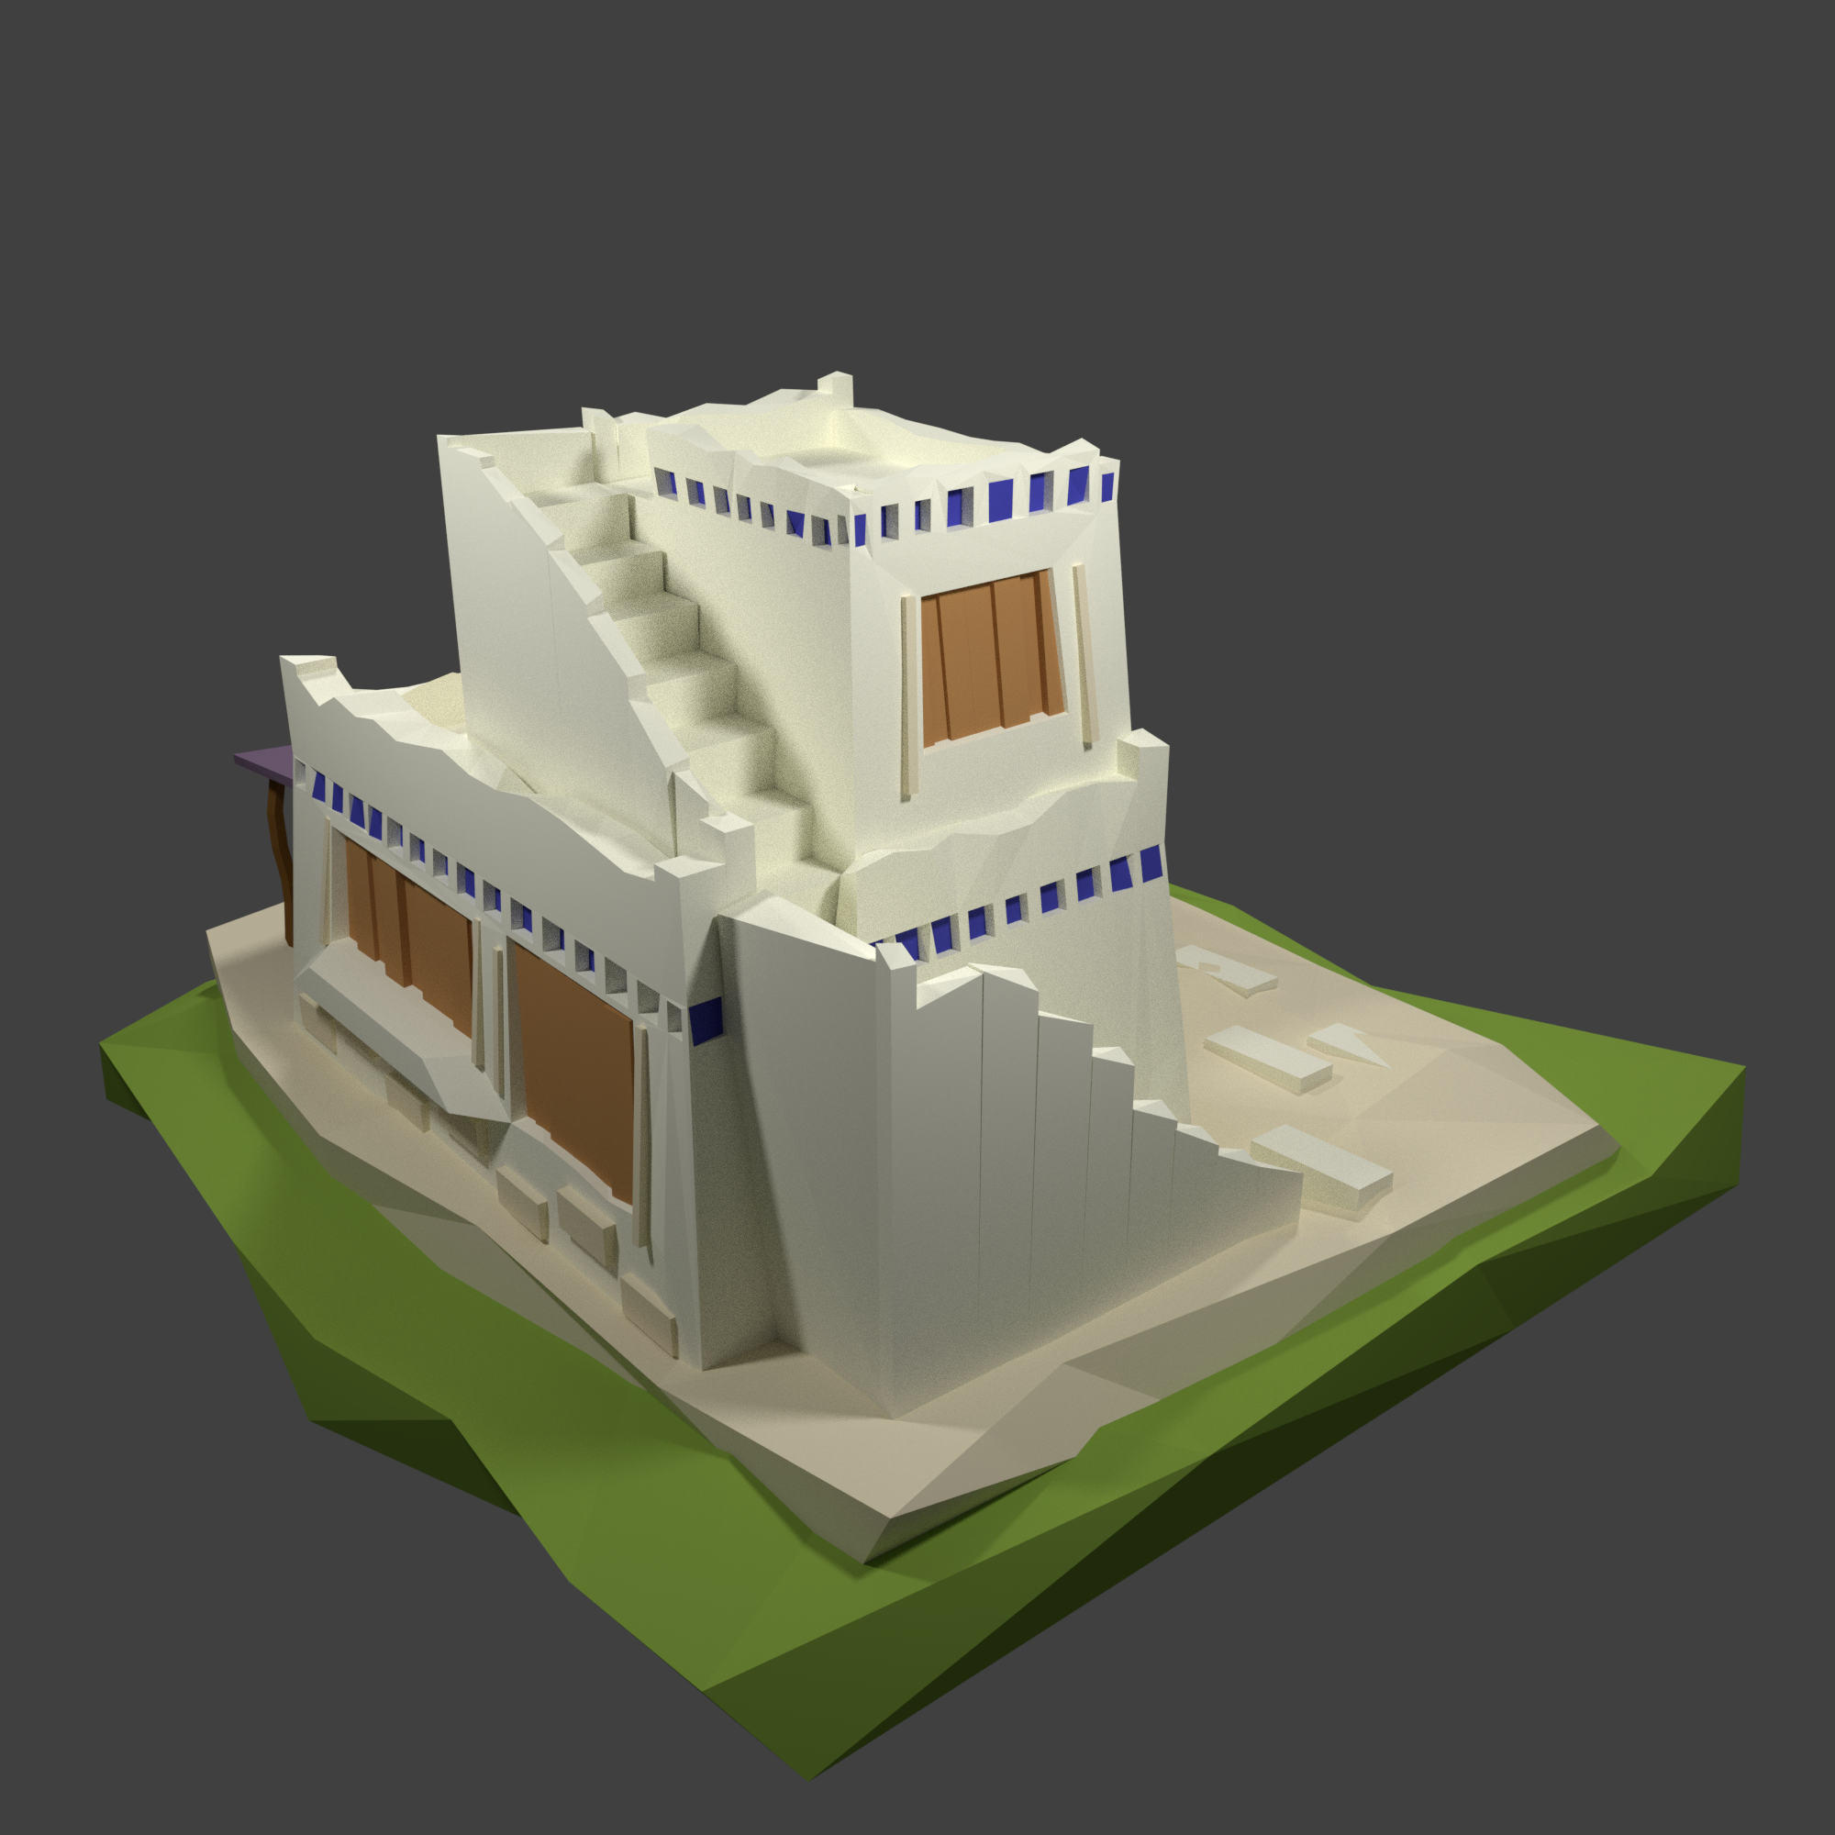
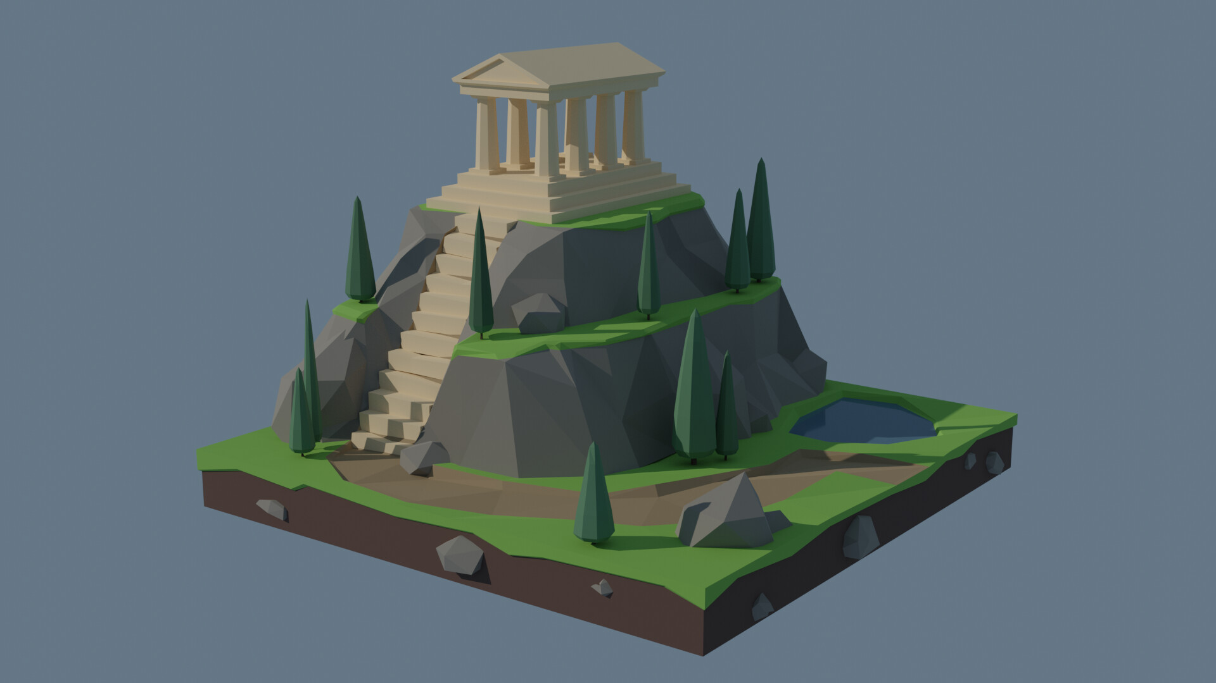
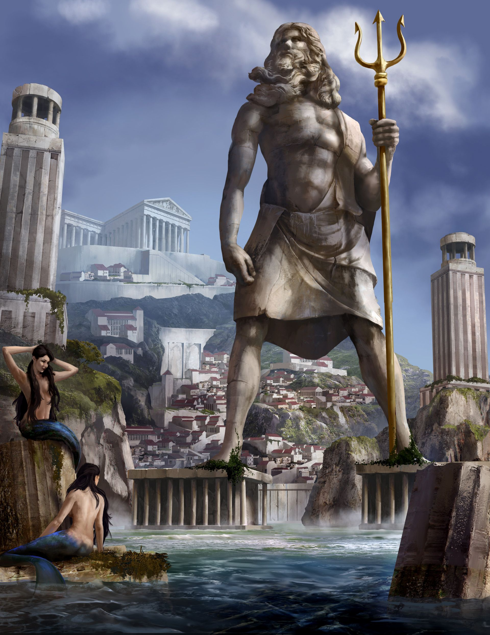
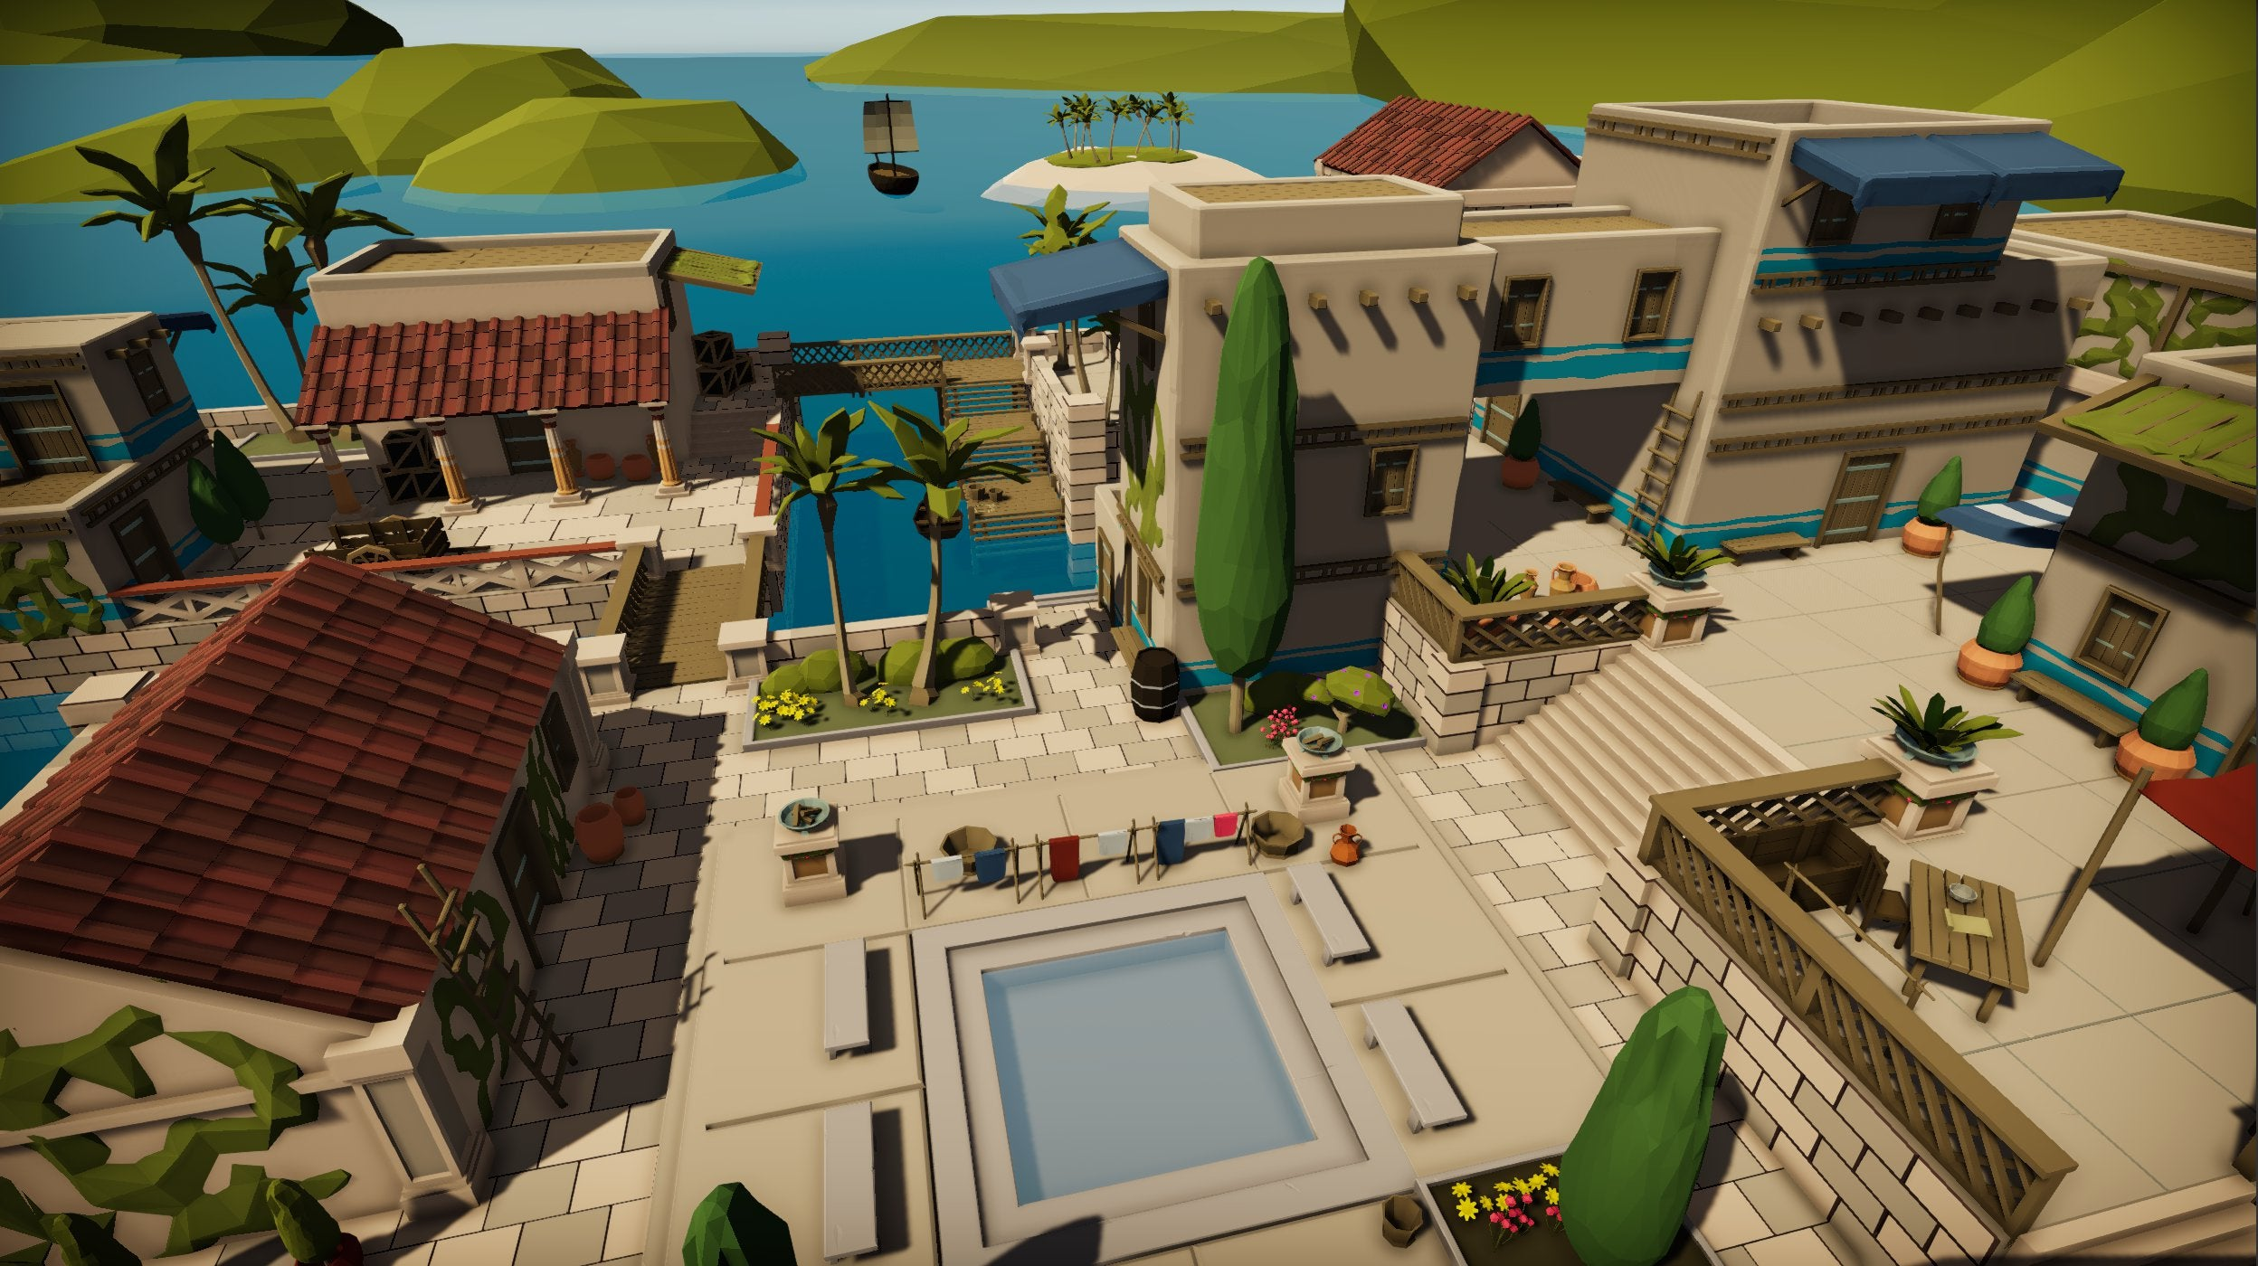
Art
Josh
3D perspective
Low Poly aesthetic for stylization, scale and optimization
Visual theme of ancient Greek with fantasy elements
Warm Colour Scheme to fit Mediterranean environment
Blocky Character style for time and optimization (Since it’s a RTS/Tower Defence)
Use of various 2D and 3D softwares

Slide 7

The Bubble
Collin
Whoever defeats the bubble first gains extra money to buy more troops.
Located at a central point.

Slide 8
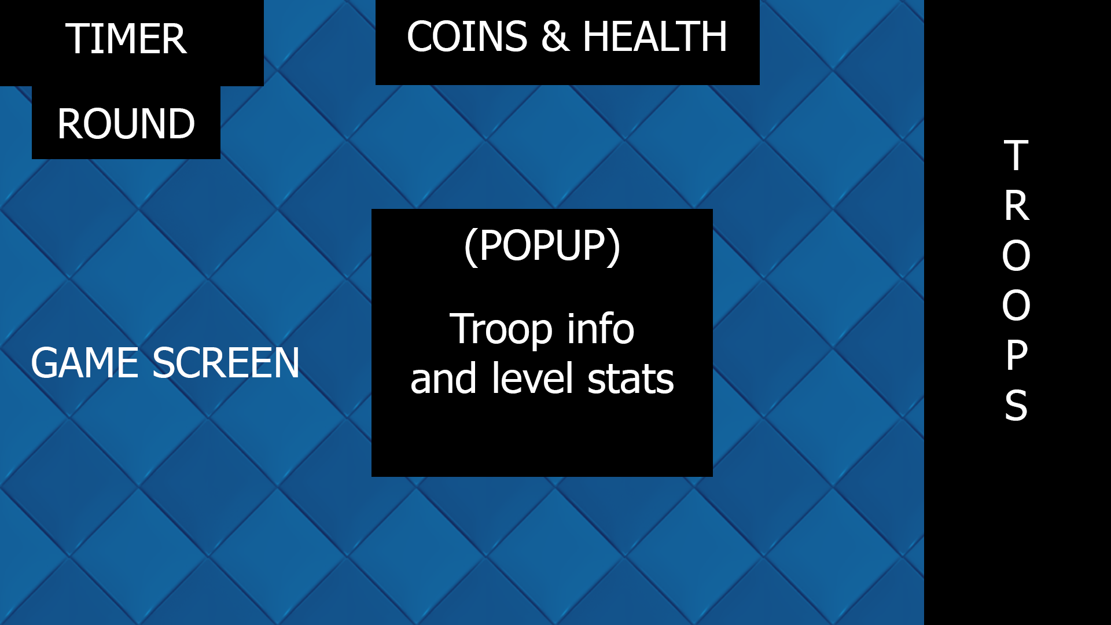
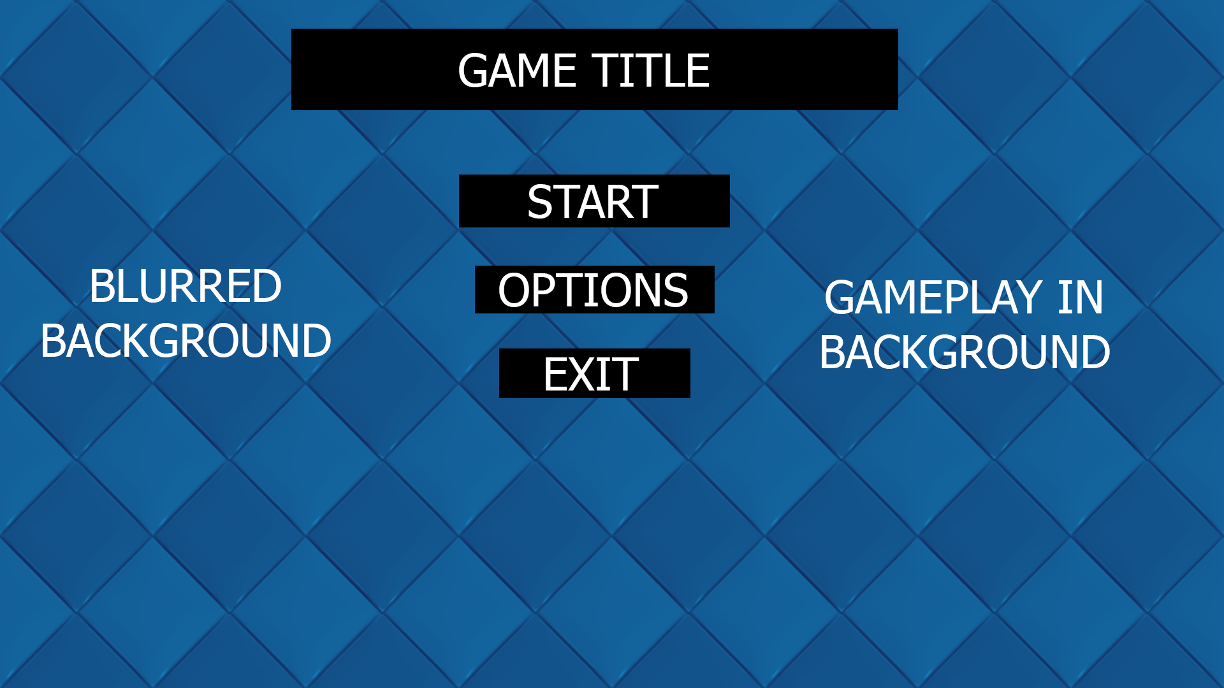
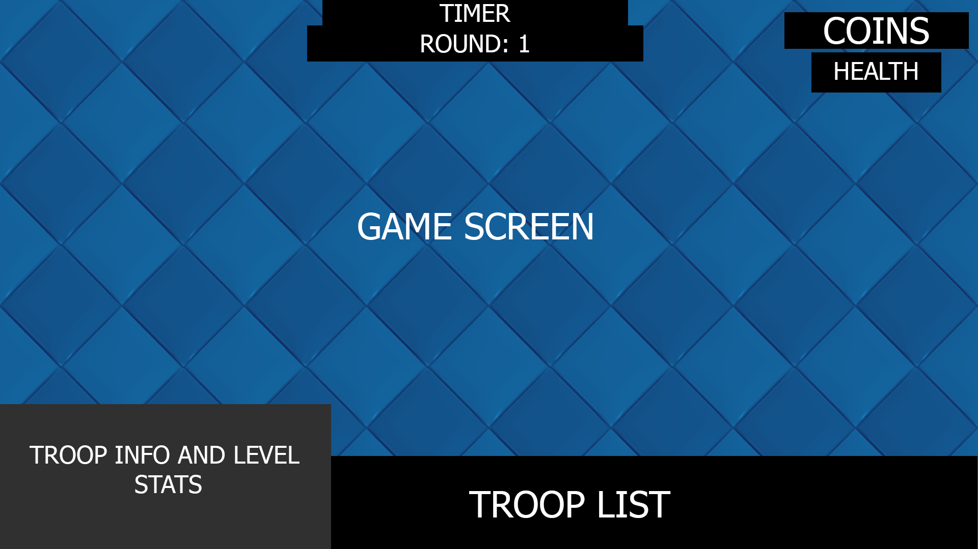
HUD & Menu
Marcel
1
3
2
Simple HUD to keep the game screen as less cluttered as possible for a more enjoyable user experience.
HUD consists of a Coins/Health/Timer/Round/Troop/Troop stats list.
In HUD template 1 as you can see the screen is more cluttered because we made the troop stats a "popup" instead of a static layout which you can see in template 2. This makes it seem more cluttered but when you remove the popup its less cluttered then HUD 2.
Hopefully during the game development phase a feature will be implemented to allow you to customize and change the HUD as you please.

Slide 9
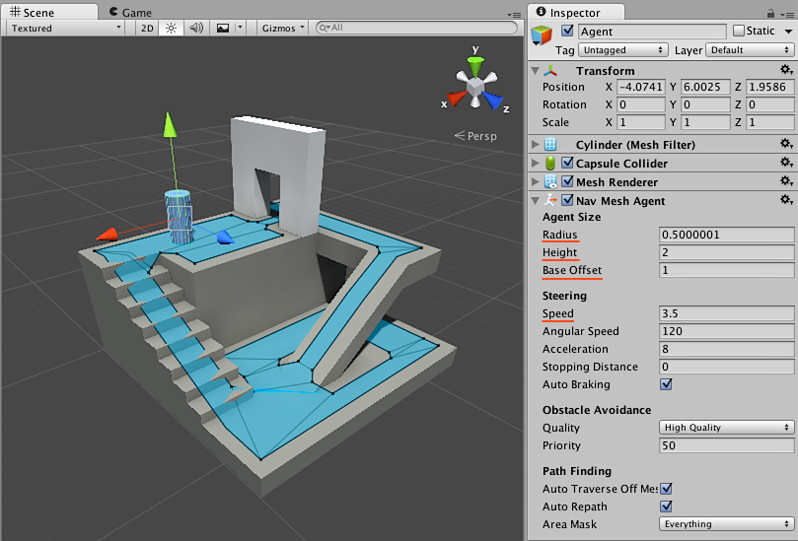
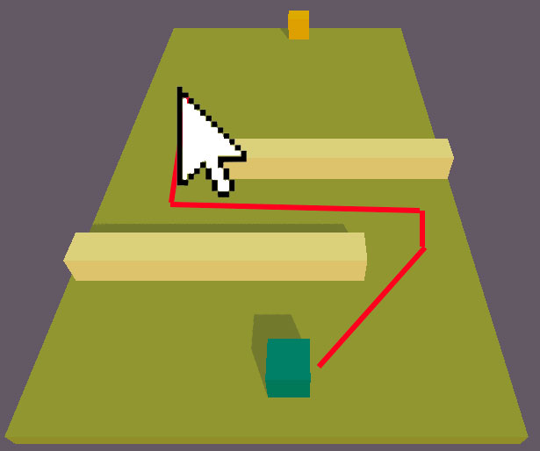
AI & Navigation
Joel
Battle for eradel will use pathfinding point & click as its movement mechanic for the “Units”, this will use unity’s in-built navigation mesh system to make “Units”/characters move to where the moused has clicked to automatically while dodging or following a path with obstacles

Slide 10
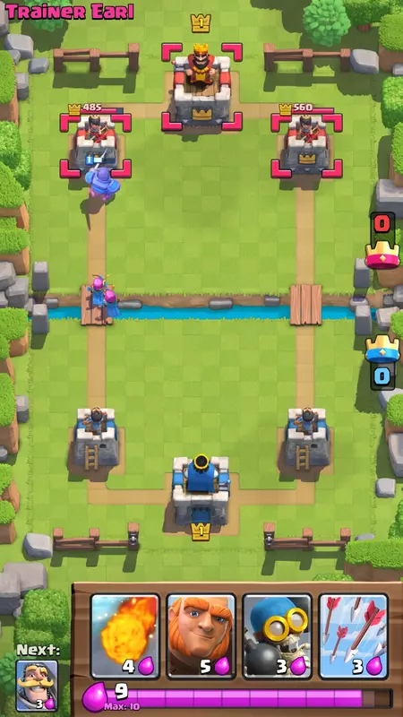


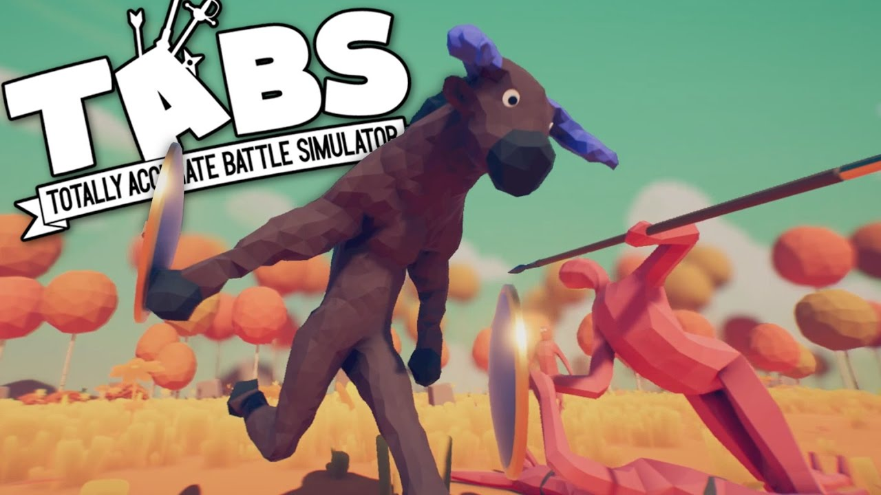
Animation & movement
Josh
There will be 3D top-down movement across a single screen
[4]
Basic satisfying animations for units, the units use soft body animations to make each and every troop move a little different, like in TABS (totally accurate battlegrounds).
[3]

Slide 11

Sound
Collin
Peaceful, medieval flute music will be the default audio.
When a battle ensues close to either player's castle, the music will switch to a more upbeat, battle march tune.
As far as other sounds go, the UI buttons will have effects when clicked which will vary depending on what each button does.

Slide 12
Level Design
Will
Procedurally generated level, will always contain 3 pathways to the enemy’s castle for the troops to take.
Example

Slide 13
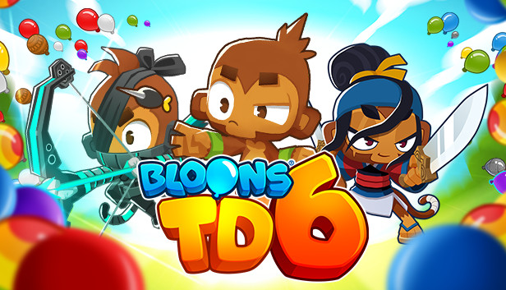

Contextual Research
Joey
Bloons Tower Defence franchise (particularly 5 and 6) inspired the base idea for the game.
Low poly style inspired by games like Totally Accurate Battle Simulator.

Slide 14

Demographic
Joel
The game is aimed at 11 to 20 year old because of its graphical style and theme.

Slide 15

Questions?

Slide 16
Bibliography
Ark – Survival Evolved (2017) [1]
Civilisation 6 (2016) [2]
Totally Accurate Battle Simulator (2019) [3]
Clash Royale (2016) [4]
Bloons Tower Defence 6 (2018) [5]
Font – Bakso Sapi - Bakso Sapi Font | dafont.com

